Slide 1
An AR-Based Coaching System for Kabaddi Using Pose Estimation and LLM Feedback
Dr. T. Mala, Mohamed Ibrahim MS,
Professor, 2024178011

Slide 2
1. Introduction
Kabaddi is a high-intensity contact sport that requires explosive movements such as toe-touch, scorpion kick, hand touch, dubki, bonus step, and jump raid. Mastery of these skills demands precise timing, balance, and body coordination.
Players—especially beginners—often struggle to correctly learn these techniques because visual demonstrations are brief, coaches may not always be available, and players cannot see their own mistakes in real time.
This project introduces an AR-based Kabaddi Ghost Trainer, where a virtual avatar demonstrates reference moves and the system evaluates how closely the player replicates them using pose estimation, sequence comparison, and feedback generation.
The goal is to help Kabaddi learners practice independently, receive real-time correction cues, and improve movements with clear visual and data-driven guidance.

Slide 3
2. Introduction (Kabaddi skills)
Toe Touch
A quick forward extension of the leg to tap the defender while maintaining balance.
Ankle Hold Pose
Forward lunge targeting ankle
Bonus Step
A long stride into the bonus line using body stretch and hip flexibility.
Thigh Hold Pose
Side-entry tackle posture
Dubki
A low-body dive used to slip under a defender’s block.
Chain Tackle Formation Pose
Coordinated multi-player defensive posture to tackle a rider
Hand Touch / Running Hand Touch
Fast hand extension during forward motion to tag defenders.
Running Raid Pose
Continuous forward locomotion Used before hand touch or toe touch
Jump Raid (Dive Escape)
A leap over defenders to avoid blocks while maintaining raid rhythm.
Scorpion Kick
A backward high kick performed when facing away from the defender.

Slide 4
2. Problem Statement
Problem:
Kabaddi learners lack continuous visual guidance, real-time correction, and objective scoring, making it difficult to accurately replicate advanced movements.
Solutions Provided By the Proposed System:
AR Playback of Reference Moves
Players can view a 3D/AR “ghost” demonstrating the correct technique, allowing them to mimic the move with proper angle and timing.
Automated Movement Analysis
The user's captured movement is processed using pose estimation and compared with expert reference sequences.
Error Identification
Joint-wise mistakes, timing mismatches, and posture deviations are detected using similarity metrics and threshold-based classifiers.
LLM-Generated Coaching Feedback
The system produces simple, actionable instructions (“Raise your right elbow higher”, “Lean less forward”, etc.) to guide improvement.
Notes:
AR Playback of Reference Moves
Automated Movement Analysis
Error Identification
LLM-Generated Coaching Feedback

Slide 5
4. Literature Survey
Paper Title | Problem addressed | Positives / What they implemented | Negatives / Limitations | Result / metric
Aleksić, J., 2024. Markerless Pose Estimation vs. 3D Marker-Based Motion Capture: Application to Countermovement Jump (CMJ). Sensors. | Validates markerless pose estimation (MMPose) for biomechanical temporal analysis by comparing to gold-standard 3D MoCap. | Uses multi-camera markerless to estimate 3D joint angles; significant real-world validation. | Focused on jump task only; limited to specific motions; requires multi-view. | RMSE = 0.035 m correlation coefficient (r) of 0.992 and 0.993
Meinard Müller. Dynamic time warping. In Information Retrieval for Music and Motion Springer, 2007. ISBN 978-3-540-74047-9. | Implementation of pose-estimation (OpenPose) + ML classifier for fall detection from video. | Concrete pipeline. Working of pose-based features in real scenes. | not sport-specific | RNN has the highest accuracy of 89% with LR=0.1 LSTM & GRU model accuracy of 98.3% with LR = 0.01
Deyzel et al. (2023), CVPR Workshops (CVSports) — One-shot skeleton-based action recognition on strength and conditioning exercises (CVPRW 2023). (CVF Open Access) | Practical skeleton-based recognition for exercise coaching with few-shot examples. | Implementation-focused: dataset of skeleton motion one-shot classification | Dataset covers conditioning exercises (not Kabaddi). | GCN metric = 46.2 Accuracy of 87.4%
Notes:
research works related to pose estimation, motion analysis, and skeleton-based learning.
The first paper by Aleksić (2024) validates markerless pose estimation by comparing it 3D motion capture systems. This work shows that markerless approaches can achieve high accuracy, making them suitable for real-world sports applications without expensive hardware.
The second paper by Lin et al. (2020) demonstrates a complete pose-based pipeline using OpenPose and machine learning classifiers. Although it is not sports-specific, it clearly establishes that pose-based features are reliable for movement analysis in real environments.
The third work by Devzel et al. (2023) focuses on skeleton-based action recognition using few-shot learning. This paper is important because it shows that skeleton representations are effective for learning and comparing movements, which directly motivates the similarity engine in my project.

Slide 6
4. Literature Survey cont.
Paper Title | Problem addressed | Positives / What they implemented | Negatives / Limitations | Result / metric
Long Liu et al. (2024), Journal of Intelligent & Systems / JISYS — Real-time pose estimation and motion tracking for sports performance (volleyball example). (ResearchGate) | Implementation of real-time pose estimation (OpenPose + tracking) and motion analytics in a sport scenario. | Integration of OpenPose + DeepSORT for multi-person tracking. handles occlusion & multi-player scenes. | Focused only on volleyball | Accuracy of 97.25% at 13.9 fps. Accuracy of 97.38% at 13.4 fps. Accuracy of 96.47% at 12.5 fps.
Ihara et al. (2024), arXiv / Mixed Reality Systems — Video2MR: Automatically generating mixed reality 3D instructional avatars by augmenting motion extracted from 2D videos. (arXiv) | Transforming 2D instructional video recordings into interactive 3D mixed reality motion instructions to assist physical training. | automatically extracts motion from 2D video and generates 3D MR avatars; highlights trajectory differences; supports time and spatial manipulation. augment existing instructional content into a 3D mixed reality format. | Requires specific hardware (HoloLens 2 + Azure Kinect); Focused on MR-only no full AR/AI training feedback loop; No personalized corrective feedback. | Baseball No.of Errors: 7 Accuracy of 93% Yoga No of Errors: 8 Accuracy of 89% Martial Arts No of Errors: 11 Accuracy of 86%
Notes:
Continuing the literature survey, this slide focuses on real-time tracking and AR/MR-based avatar systems.
Long Liu et al. (2024) propose a real-time pose estimation and tracking framework using OpenPose and DeepSORT. Their work highlights how pose tracking can be used effectively in sports environments, even with occlusions and multiple players.
Ihara et al. (2024) present a system that converts 2D instructional videos into mixed-reality 3D avatars. This paper is particularly relevant to my project because it demonstrates how motion extracted from videos can be transformed into interactive 3D avatars, which aligns closely with the idea of ghost trainers.
However, this system lacks an automated feedback loop, which my project aims to address.

Slide 7
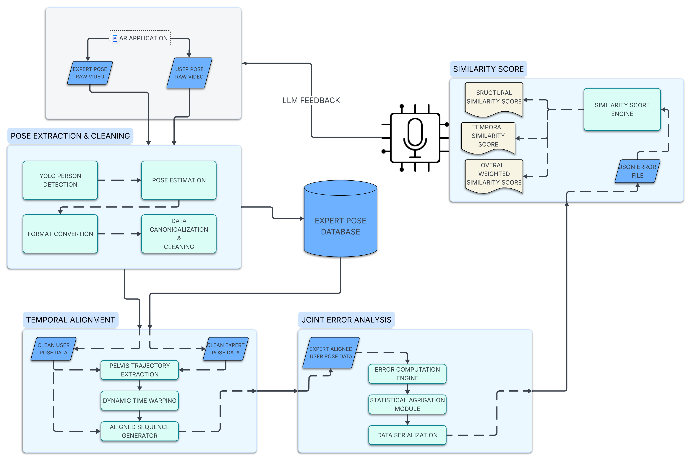
5. Overall System Architecture (High Level)

Slide 8
6. Modules
Pose Extraction & Cleaning
YOLO PERSON DETECTION (RAIDER)
POSE ESTIMATION
FORMAT CONVERTION
DATA CANONICALIZATION
TEMPORAL ALIGNMENT
PELVIS TRAJECTORY EXTRACTION
DYNAMIC TIME WARPING
ALIGNED SQUENCE GENERATOR
JOINT ERROR ANALYSIS
ERROR COMPUTATION ENGINE
STATISTICAL AGGREGATION MODULE
DATA SERIALIZATION
SIMLARITY SCORE
SIMILARITY SCORE ENGINE

Slide 9
6 A. Modules (POSE EXTRACTION & CLEANING)
Module 1: POSE EXTRACTION & CLEANING
SUB-MODULES :
YOLO PERSON DETECTION
POSE ESTIMATION
FORMAT CONVERTION
DATA CANONICALIZATION & CLEANING

Slide 10
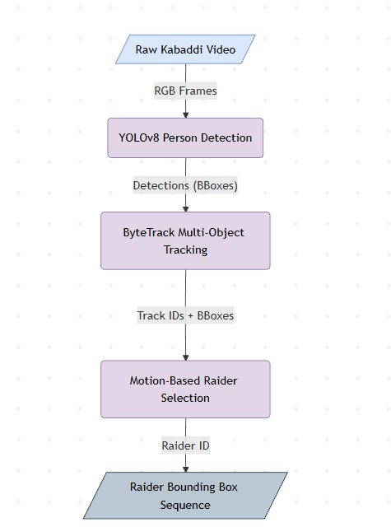
6A (i) – Module Overview & Block Diagram
SUB-Module:
YOLO-Based Person Detection and Tracking
Block Diagram:

Slide 11
6A (i) – Algorithm Details
Algorithms Used
YOLOv8 – Object Detection
Role: Detect all human instances in each frame.
Result: B = { (x1, y1, x2, y2, confidence, class=person) }
ByteTrack – Multi-object Tracking
Role: Assign persistent IDs to detected persons across frames.
Result: Track ID → Sequence of bounding boxes over time
Motion-Based Raider Selection (Heuristic) “Cumulative Displacement Heuristic”
Formula:
motion_i = Σ || position_t − position_(t−1) ||
raider = argmax(motion_i)

Slide 12
6A (i)– Algorithm Details cont.
Final OUTPUT:
Raider_BBoxes = {
frame_1: (x1, y1, x2, y2),
frame_2: (x1, y1, x2, y2),
...
}
Sample I/P, O/P:
Sample Input: raw video with 5–7 players visible
Sample Output (video with annotations)
Frame 45:
Raider ID = 3
Bounding Box = (420, 180, 610, 520)

Slide 13
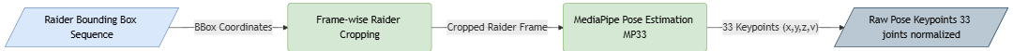
6A (ii) – Module Overview & Block Diagram
Module Name
Pose Estimation using MediaPipe BlazePose
Block Digram:

Slide 14
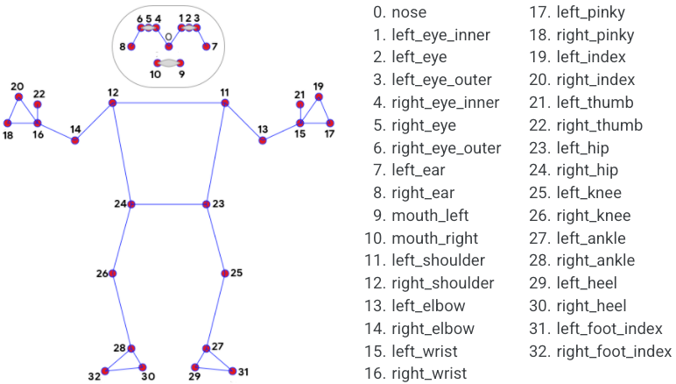
6A (ii) Algorithm Details
Algorithm Used
MediaPipe BlazePose (33-Keypoint Model)
Step 1: Raider-Locked Frame Cropping
Input: Frame + Raider Bounding Box
Padding: ±40 pixels
Clipping: Stay within frame bounds
Result: Tight region of interest (ROI) containing only the raider
Step 2: MediaPipe Pose Estimation
CNN-based pose estimation model
Trained for full-body human pose
Configuration Used
Videos (not static image)
Temporal landmark smoothing enabled
Confidence thresholds applied internally

Slide 15
6A (ii) Algorithm Details (cont)
Sample Input & Output
Sample Input
Frame 120
Raider Bounding Box = (420, 180, 610, 520)
Sample Output
Pose[120] =
[
(0.48, 0.12), # nose
(0.46, 0.10), # left eye
...
(0.52, 0.91) # right foot
]
Shape:
(33 joints × 2 coordinates)

Slide 16
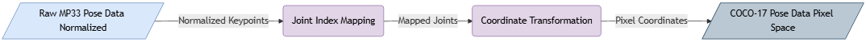
6A (iii) Module Overview & Block Diagram
Module Name
Format Conversion: MediaPipe-33 to COCO-17
Block diagram:

Slide 17
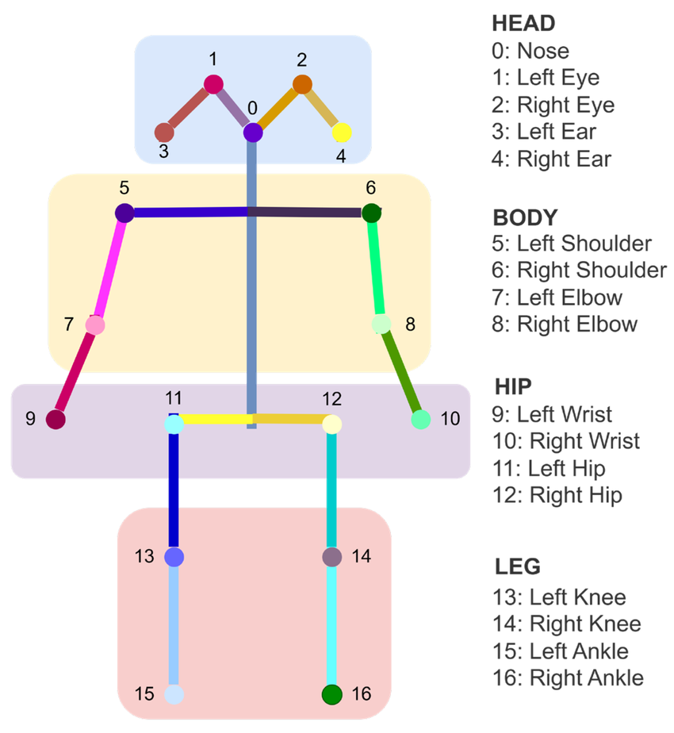
6A (iii) Algorithm Details
Algorithm Type
Deterministic Joint Index Mapping + Coordinate Transformation
Step 1: Joint Index Mapping
Each COCO-17 joint is mapped to a specific MediaPipe landmark index.
Mapping Table (Fixed)

Slide 18
6A(iii) Algorithm Details (cont)
Step 2: Coordinate Transformation
Transformation Formula
For each joint:
x_pixel = bbox_x1 + lm.x × bbox_width
y_pixel = bbox_y1 + lm.y × bbox_height
Visibility Rule
If landmark visibility < 0.5:
(x, y) = NaN

Slide 19
6A(iii) Algorithm Details (cont)
Sample Input & Output
Sample Input:
Sample Output:
MP33 landmark (left shoulder):
(x = 0.42, y = 0.36)
Bounding Box:
x1 = 400, y1 = 150
width = 200, height = 400
COCO-17 left shoulder:
X = 400 + 0.42 x 200 = 484
y = 150 + 0.36 x 400 = 294

Slide 20
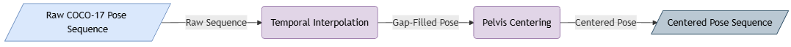
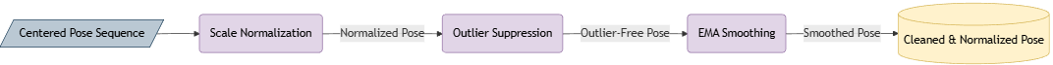
6A(iv) Module Overview & Block Diagram
Module Name
COCO-17 Pose Canonicalization and Temporal Cleaning
Block diagram:

Slide 21
6A(iv) Algorithms Used
Algorithm Type:
Deterministic Signal-Processing Pipeline (5 Steps)
Step 1: Temporal Interpolation
Algorithm: (Rule Based) Linear Interpolation Across Time
Rule
Interpolates only if at least two valid frames exist for a joint
Step 2: Pelvis Centering (Translation Normalization)
Algorithm: Pelvis-Based Centering
Formula:
pelvis(t) = (left_hip + right_hip) / 2
joint_centered = joint − pelvis(t)

Slide 22
6A(iv) Algorithms Used (cont)
Step 3: Scale Normalization
Algorithm Torso-Length Normalization
Formula
torso_length = || shoulder_center − hip_center ||
joint_normalized = joint_centered / torso_length
Step 4: Outlier Suppression
Algorithm Z-Score Velocity-Based Outlier Detection
velocity(t) = || pose(t) − pose(t−1) ||
z = (velocity − μ) / σ
If |z| > 3.0 → replace pose(t) with pose(t−1)

Slide 23
6B Modules (POSE EXTRACTION & CLEANING)
Module 2: POSE EXTRACTION & CLEANING
SUB-MODULES :
PELVIS TRAJECTORY EXTRACTION
DYNAMIC TIME WARPING
ALIGNED SQUENCE GENERATOR

Slide 24
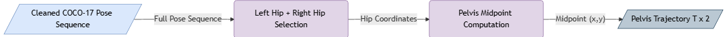
6B (i) – Module Overview & Block Diagram
SUB-Module:
PELVIS TRAJECTORY EXTRACTION
Block Diagram:

Slide 25
6B(i) Algorithm Details
Algorithm Type
Deterministic Anatomical Anchor Extraction
Joint Selection
From COCO-17 skeleton:
Left Hip → Joint index 11
Right Hip → Joint index 12
These joints are guaranteed to exist after Level-1 cleaning.
Pelvis Computation Formula
For each frame t:
pelvis(t) = (pose[t, 11] + pose[t, 12]) / 2,
Where: pose[t, j] is the (x, y) coordinate of joint j at frame t

Slide 26
6B(i) Algorithm Details (cont)
Sample Input & Output
Sample Input
Sample Output
Frame 40:
Left Hip = (-0.12, 0.05)
Right Hip = ( 0.08, 0.04)
Pelvis(40) = ((-0.12 + 0.08)/2, (0.05+0.04)/2)
= (-0.02, 0.045)

Slide 27
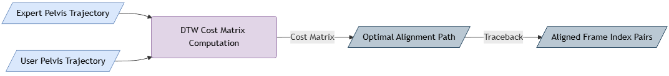
6B (ii) – Module Overview & Block Diagram
SUB-Module:
Dynamic Time Warping for Temporal Alignment
Block Diagram:

Slide 28
6B (ii) – Algorithm Details
Algorithm Type
Dynamic Programming-Based Temporal Alignment
Step 1: Cost Matrix Construction
Distance Metric
For expert frame i and user frame j:
d(i, j) = || expert_pelvis[i] − user_pelvis[j] ||
Step 2: Optimal Path Backtracking
Backtracking Rule
Start from:
(i, j) = (T_expert, T_user)
At each step, move to the minimum of:
D[i−1, j−1], D[i−1, j], D[i, j−1]
Termination condition :
(i == 0 AND j == 0)

Slide 29
6B (ii) – Algorithm Details (cont)
Sample Input & Output
Sample Input
Expert length = 100 frames
User length = 120 frames
Sample Output
Aligned length = 115 frames
path_expert = [0,1,1,2,3,3,4,...]
path_user = [0,1,2,3,4,5,5,...]

Slide 30
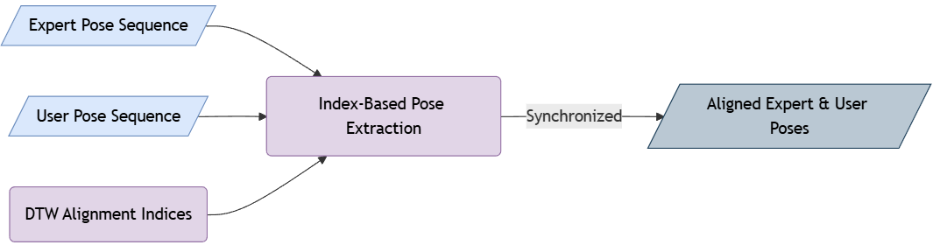
6B (iii) – Module Overview & Block Diagram
SUB-Module:
Index-Based Aligned Pose Sequence Generation
Block Diagram:

Slide 31
6B (iii) Algorithm Details
Algorithm Type
Direct Index-Based Pose Extraction
Aligned Pose Construction Rule
For each aligned frame index i:
expert_aligned[i] = expert_pose[path_expert[i]]
user_aligned[i] = user_pose[path_user[i]]
On Condition:
expert_aligned.shape == user_aligned.shape

Slide 32
6B (iii) Algorithm Details (cont)
Sample Input & Output
Sample Input
Expert pose length = 100 frames
User pose length = 120 frames
DTW paths:
path_expert = [0,1,1,2,3,3,4]
path_user = [0,1,2,3,4,5,5]
Sample Output
Aligned length = 7 frames
expert_aligned: [pose_0, pose_1, pose_1, pose_2, pose_3, pose_3, pose_4]
user_aligned: pose_0, pose_1, pose_2, pose_3, pose_4, pose_5, pose_5]

Slide 33
6C Modules (JOINT ERROR ANALYSIS)
Module 3: JOINT ERROR ANALYSIS
SUB-MODULES :
ERROR COMPUTATION ENGINE
STATISTICAL AGGREGATION MODULE
DATA SERIALIZATION

Slide 34
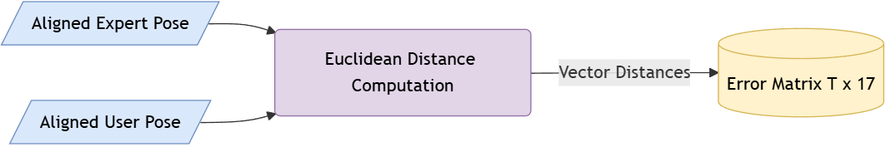
6C(i) Module Overview & Block Diagram
SUB-Module:
Frame-wise and Joint-wise Error Computation Engine
Block Diagram:

Slide 35
6C (i) Algorithm Details
Algorithm Type
Deterministic Distance Computation
Frame-wise Joint Error Formula
For frame t and joint j:
error(t, j) = || expert(t, j) − user(t, j) ||₂
error(t, j) = sqrt( (x_e − x_u)² + (y_e − y_u)² )
Where:
(x_e, y_e) → expert joint coordinates
(x_u, y_u) → user joint coordinates

Slide 36
6C (i) Algorithm Details (cont)
Sample Input & Output
Sample Input
Frame 25
Joint: Left Knee
Expert: (0.45, 0.78)
User: (0.52, 0.71)
Sample Output
error = sqrt((0.45−0.52)² + (0.78−0.71)²)
≈ 0.099
Stored at:
error_matrix[25][left_knee]

Slide 37
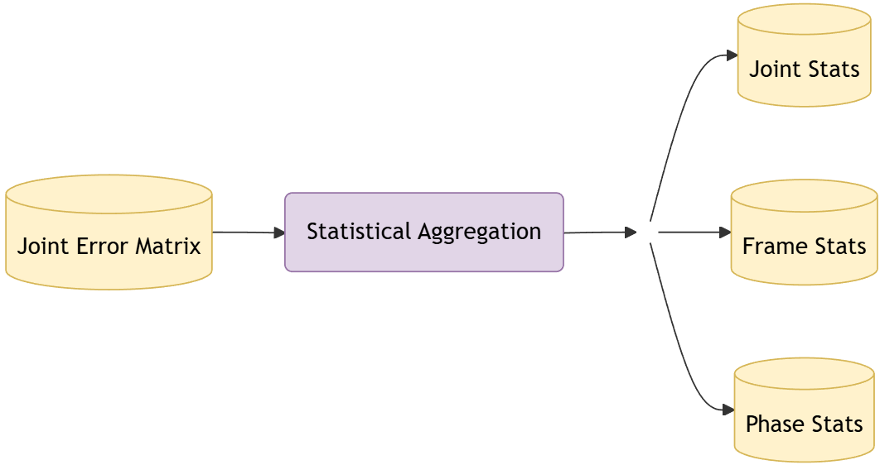
6C(ii) Module Overview & Block Diagram
SUB-Module:
STATISTICAL AGGREGATION MODULE
Block Diagram:

Slide 38
6C (ii) Algorithms Details
Algorithm Type
Deterministic Statistical Aggregation
1. Joint-wise Temporal Aggregation
Statistics Computed (per joint)
For joint j:
mean_error(j) = (1/T) Σ error(t, j)
max_error(j) = max(error(t, j))
std_error(j) = standard deviation(error(t, j))
Output
17 joints → {mean, max, std}

Slide 39
6C (ii) Algorithms Details (cont)
2. Frame-wise Spatial Aggregation
Statistics Computed (per frame)
For frame t:
mean_error(t) = (1/17) Σ error(t, j)
max_error(t) = max(error(t, j))
Output
T frames → {mean_error, max_error}

Slide 40
6C (ii) Algorithms Details (cont)
3. Temporal Phase-wise Aggregation
Phase Definition
Given total frames T:
Early phase: frames [0, T/3)
Mid phase: frames [T/3, 2T/3)
Late phase: frames [2T/3, T)
Phase Statistics
For each phase p and joint j:
phase_error(p, j) = mean(error(t, j)) for t ∈ phase p
Output
3 phases × 17 joints

Slide 41
6C (ii) Algorithms Details (cont)
4. Frame–Joint Error Export
Export Structure
Frame t:
joint_0 → error
joint_1 → error
...
joint_16 → error
Sample Input & Output
Sample Input
error_matrix[40][left_knee] = 0.082
error_matrix[41][left_knee] = 0.091
Sample Output
left_knee:
mean = 0.042
max = 0.089
std = 0.018

Slide 42
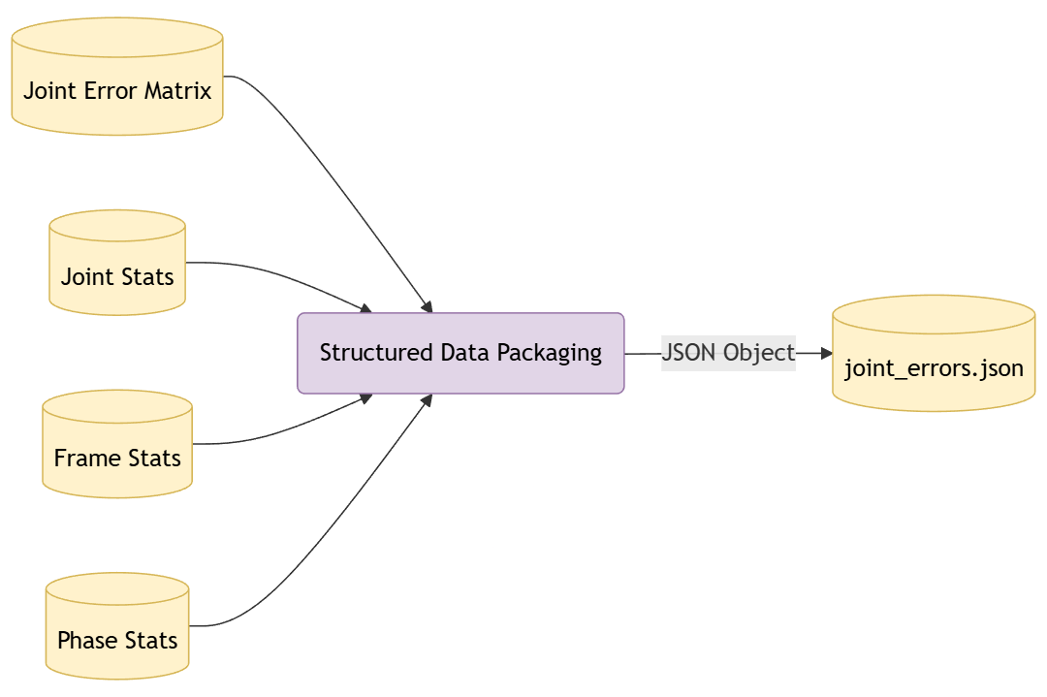
6C(iii) Module Overview & Block Diagram
SUB-Module:
DATA SERIALIZATION
Block Diagram:

Slide 43
6C (iii) Algorithm Details
Algorithm Type
Deterministic Data Packaging & Export
JSON Structure
1. Metadata Section
3. Frame Statistics
Overall body deviation per frame.
frame_statistics:
frame_index:
mean_error
max_error
metadata:
num_frames
num_joints
alignment_method
expert_pose_path
user_pose_path
4. Phase Statistics
Temporal progression of joint errors.
phase_statistics:
early:
joint_name → mean_error
mid:
joint_name → mean_error
late:
joint_name → mean_error
2. Joint Statistics
Summarized performance per joint.
joint_statistics:
joint_name:
mean
max
std
5. Frame–Joint Error Export
Full error detail retained.
frame_joint_errors:
frame_index:
joint_name → error

Slide 44
6C (iii) Algorithms Details (cont)
Sample Input & Output
Sample Input
left_knee:
mean = 0.042
max = 0.089
std = 0.018
Serialized Output
"left_knee": {
"mean": 0.042,
"max": 0.089,
"std": 0.018
}

Slide 45
6D Modules (SIMILARITY SCORING)
Module 4: JOINT SIMILARITY SCORING
SUB-MODULES :
SIMILARITY SCORE ENGINE

Slide 46
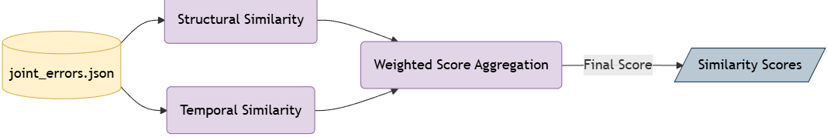
6D (i) Module Overview & Block Diagram
Module Name
SIMILARITY SCORE ENGINE
Block Diagram

Slide 47
6D (i) Scoring Algorithms
Algorithm Type
Deterministic Score Aggregation
1. Structural Similarity Score
Extract mean joint errors: mean_errors = { mean_error(j) for all 17 joints }
Compute overall mean joint error: mean_joint_error = nanmean(mean_errors)
Normalize using fixed threshold: structural_similarity = (1 − mean_joint_error / MAX_ERROR_THRESHOLD) × 100
Where: MAX_ERROR_THRESHOLD = 1.5 Clamp result to [0, 100].
2. Temporal Similarity Score
Extract aligned frame count: T_aligned
Compare with baseline: BASELINE_FRAMES = Expert_Total_Frames
Compute deviation: frame_deviation = |T_aligned − BASELINE_FRAMES|
Normalize deviation: temporal_quality = 1 − (frame_deviation / (BASELINE_FRAMES × 0.5))
Scale to score range: temporal_similarity = 70 + (temporal_quality × 30)

Slide 48
6D (i) Scoring Algorithms (cont)
3. Overall Similarity Score
Weighted Aggregation
overall_score = 0.6 × structural_similarity + 0.4 × temporal_similarity
Sample Input & Output
Sample Input
mean_joint_error = 0.48
T_aligned = 103
Sample Output
structural_similarity ≈ 68%
temporal_similarity ≈ 93.7%
overall_score ≈ 78.3%

Slide 49
THANK YOU

